Slide 1
Window Bangers
Group 9
Thomas McCarthy (Designer)
Jayden Murray (Designer)
Cristian Hanganu (Programmer)

Slide 2
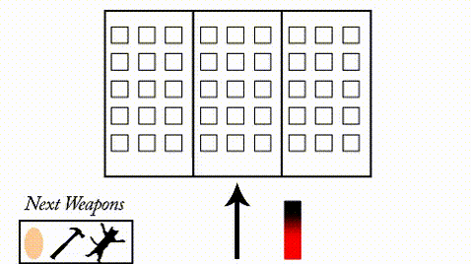
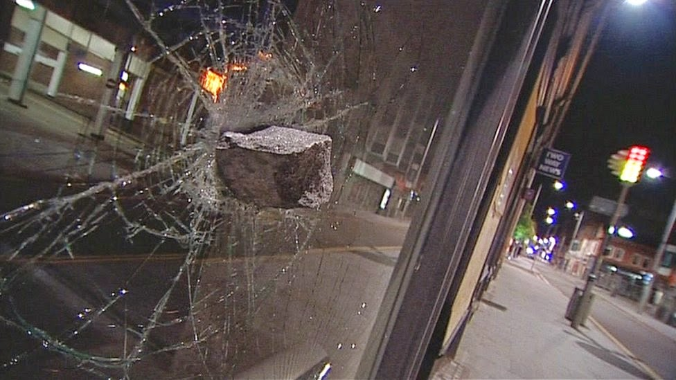
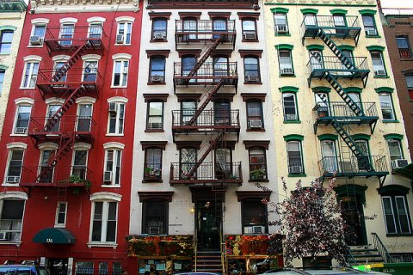
Genre/ Style’s
Competitive 2 Players
2D Destruction
Comedic Components
Notes:
We were thinking of a dart game, this includes turn taking mechanics, score mechanic, enabling competition
However we found this idea to be too generic
So we thought of another theme that we could design, which is a balloon popper game, which

Slide 3
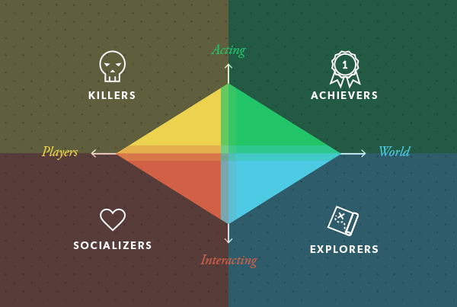
Target Demographic
Gender:
Males
Age:
13+
Achiever:
Interaction with in game-world
Notes:
Acting on the world and achieve breaking all the windows and win

Slide 4
Mechanics
Can mark windows with eggs
Arrow direction and power bar to shoot
Score
Events to give players extra points
Turn taking
Notes:
When a player shoots an egg at a window, that window is worth double points for the next player that smashes it. (High risk and reward).
Sometimes , a random person might appear , if the player hit that person with a brick , gets extra points.
A player will tap once for the angle of fire, and again for power.

Slide 5
Game Flow
Symmetrical Gameplay
Players take turns to throw objects through residents windows.
Not every brick will go through a window.
Events will take place, which will offer bonus points.
Players tap to select an angle and then tap again for power.
Player with the most points after all windows smashed

Slide 6
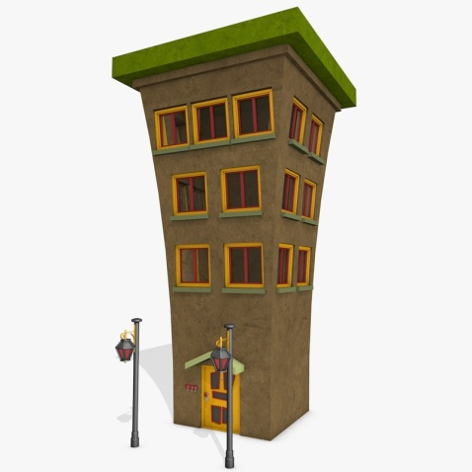

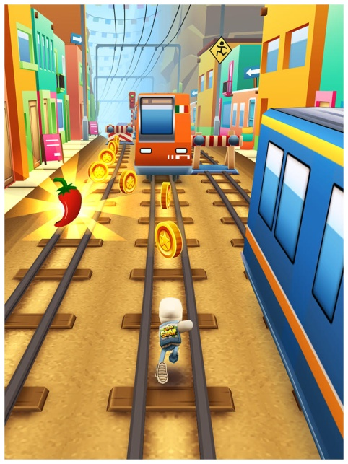




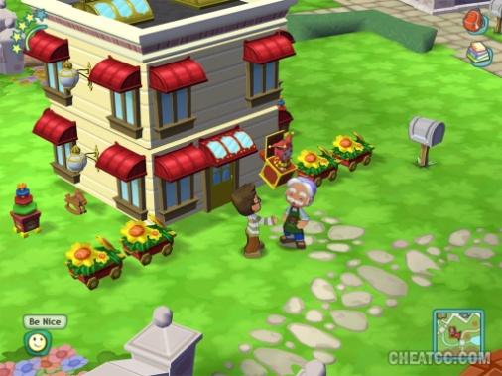


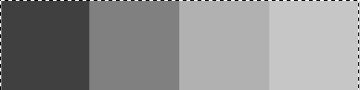
Art
Notes:
Colour Palettes: The palette at the bottom of the slide is what I think the final palette should be, there is a variety of colours that all contrast very well since I’ve changed their values and made them not too high or too low. I chose these colours because they are kind of like circus colours with red, blue, yellow and purple and so they might make a person more attracted too it because they’re reminded of all the fun they had at circus’ or carnivals. The brighter colours will also work with the possible cartoon art style since both of them together make the game look a lot more casual and easy to play for the target audience.
Art Style: The art style we should use I think should be a cartoon style so that the game doesn’t look like it’s trying to be very serious as a few dart apps that I looked at look too realistic and so don’t give off the casual vibe when playing them or looking at their app page. The only problem with this would be having to make sure that the game isn’t too cartoonish as to give the impression that it’s a kids game. As this has a simple HUD and a cartoon-like art style so that the player can tell it’s not a very serious game and can be played casually. The HUD that they have is also a good example since they keep everything neat without any advertisements or clutter.
Optional Art Style: I also think a good possibly art style would be to have the futuristic/technology type board and background as this is very minimalist meaning the players has nothing to get them confused and they can just play the game. When they look at it, everything is clearly displayed and attracts a lot of attention because of their multiple colours and animated lights in the background. The colours are high value on low value so the contrast makes the buildings and items stand out.
Art style
Colours
Optional art style

Slide 7
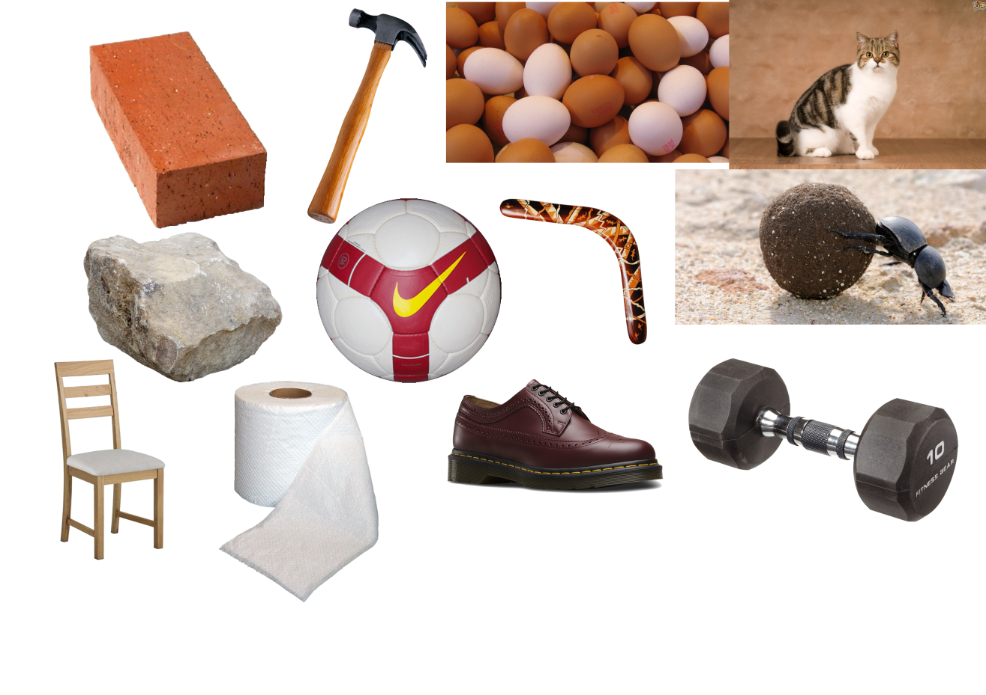
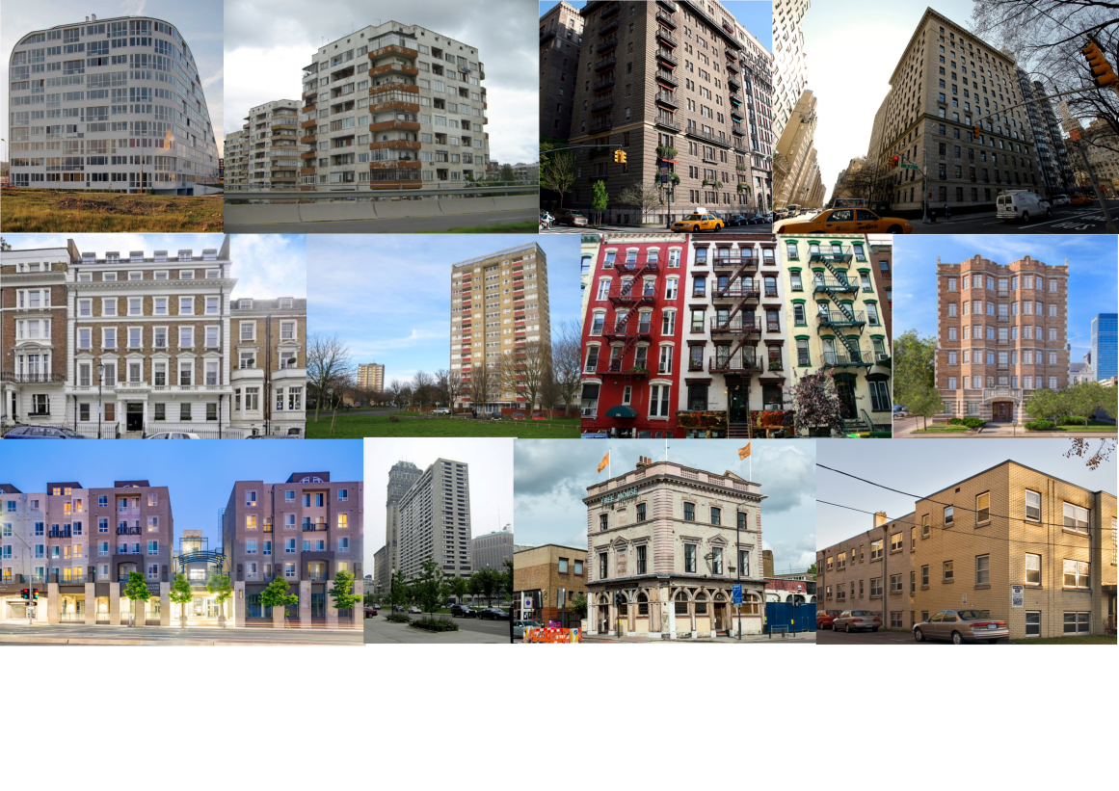
Mood Boards
Notes:
Left Board: This board is showing a variety of different items that can be used in the game to smash the windows and they all vary in weight and size going from toilet roll and shoes to Dumbells and chairs. I was thinking that these could be implemented into the game as options for players to pick from that would make it harder to throw or easier to throw depending on the item. Some items might even score bonus points if thrown at a window before another one (For example, throwing an egg at a window will “mark it” and smashing that window on your next turn would give you bonus points.
Right Board: This board is all different types of apartment blocks, I tried to look for apartments that have a lot of windows and also vary in location. The change in Windows would make the games difficulty also change since there would be more or less targets depending on the type of building chosen by the players. The location could also be good to look into as certain players might enjoy playing in locations that they find familiar such as London or New York.

Slide 8
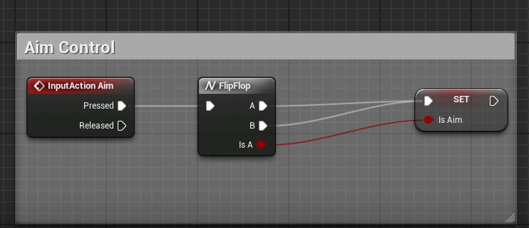
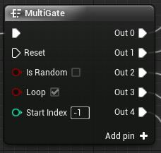
Code
Multi-Gate / Flip Flop
Booleans
Loops
Score
Notes:
When it comes to turn based game , the best thing I could think of is the Multi-Gate and Flip Flop.
Also Booleans are an important part that will help us reach our objective.
Loops will help us maintaining the same pattern , so it could run again and again until a specific point is reached.

Slide 9
Any Questions?

